Slide 1
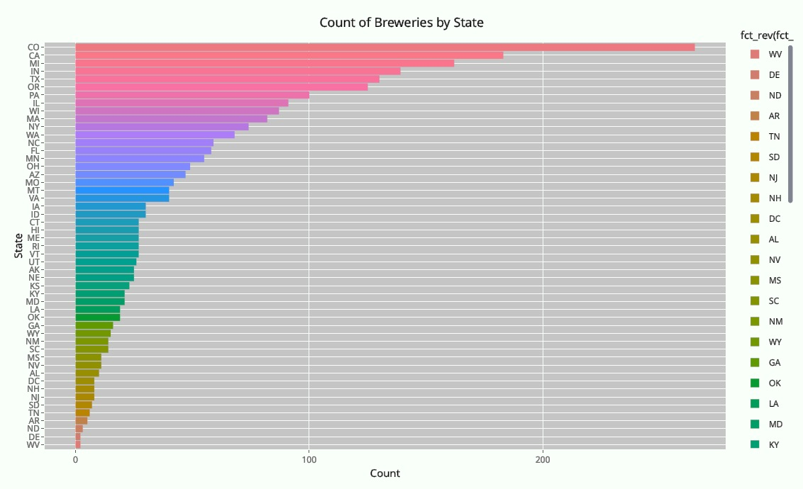
CRAFT BEER
US MARKET PENETRATION

Slide 2

American Craft Brewery:
Insights and Analysis.
Great Marks Private Equity, based in Denver Colorado, has retained AGH Data Consult Inc. to evaluate certain craft beer data, provide insights and help chart additional steps toward entering this unique and growing market. Focus of this study sought to address among other things:
Market penetration of craft brewers by state.
The Alcohol By Volume (ABV) of American craft beer
The International Bitterness Units (IBU) of American craft beer
Investigate any relationship between the ABV and IBU
Investigate if the State of brew has any impact on the ABV or IBU or both
AGH DATA
CONSULT
Spring 2019

Slide 3

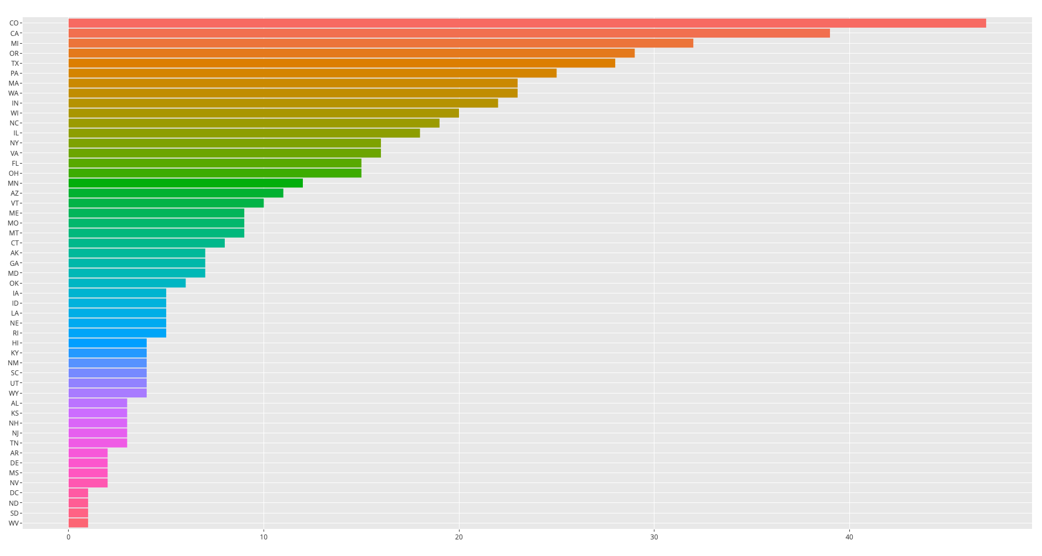
Number of Breweries per State
Daestrunt od qui que sectur as modi cumqui inus si bea non nus exeratio. Mil exerro erferum re corro omnient quam atiat.
STOCK
HOLDER

Slide 4
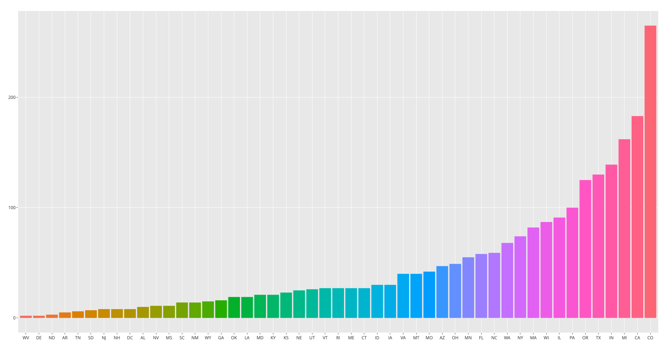
Count of Beer Brands per State
Daestrunt od qui que sectur as modi cumqui inus si bea non nus exeratio. Mil exerro erferum re corro omnient quam atiat.
STOCK
HOLDER
150
100
50

Slide 5
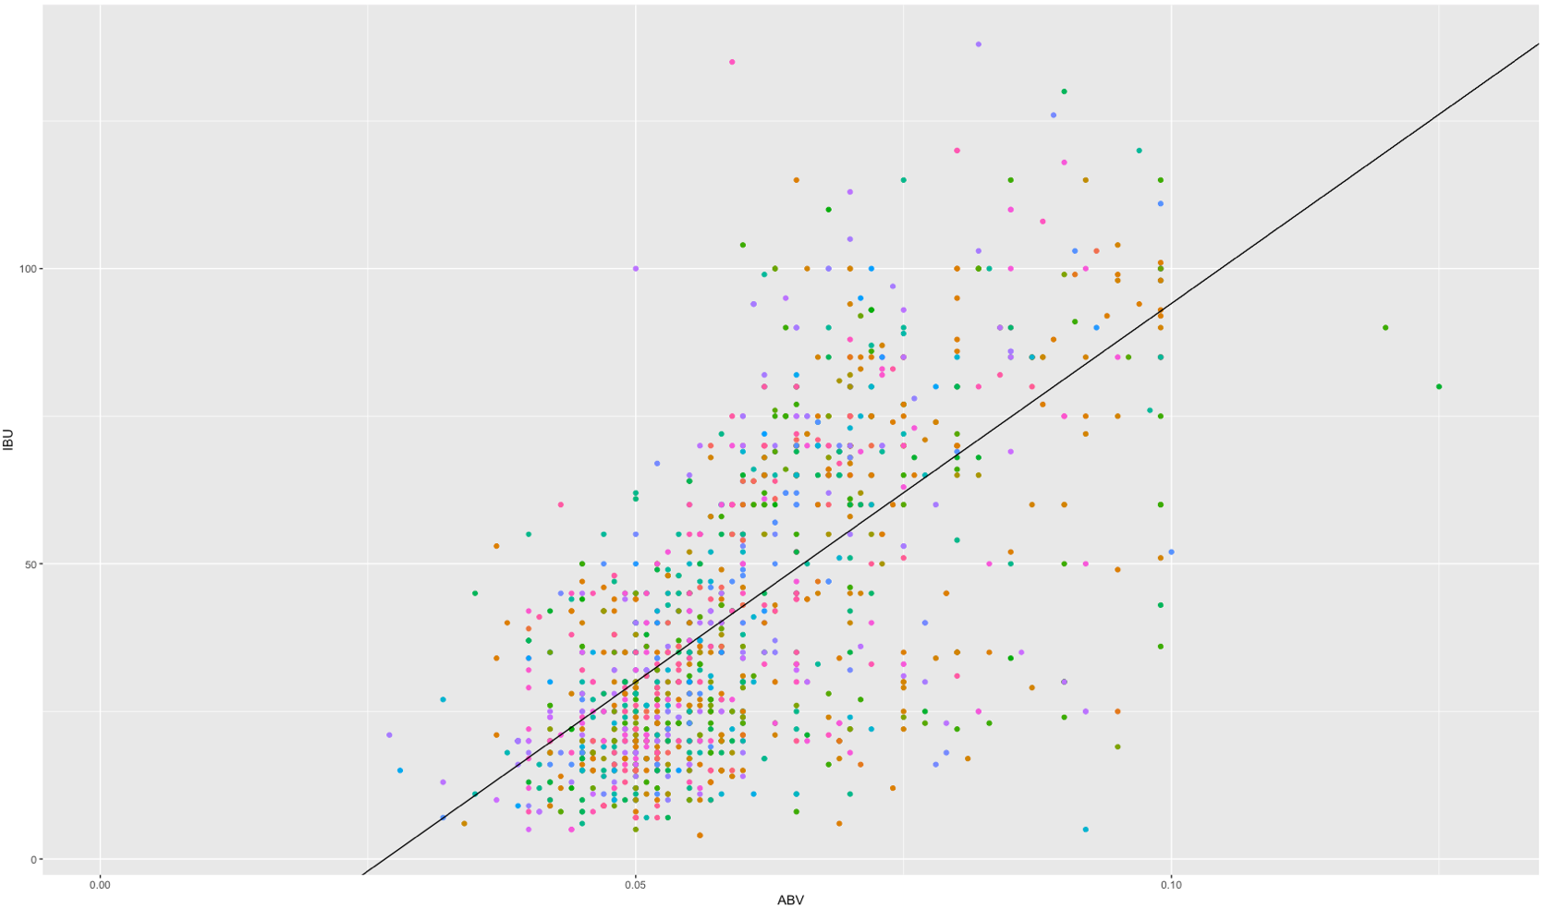
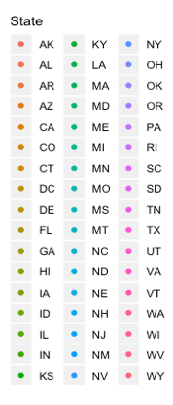
ABV vs IBU per State
STOCK
HOLDER
Higher Concentration
Scatter plot of ABV vs IBU by state.
Colored by state.

Slide 6
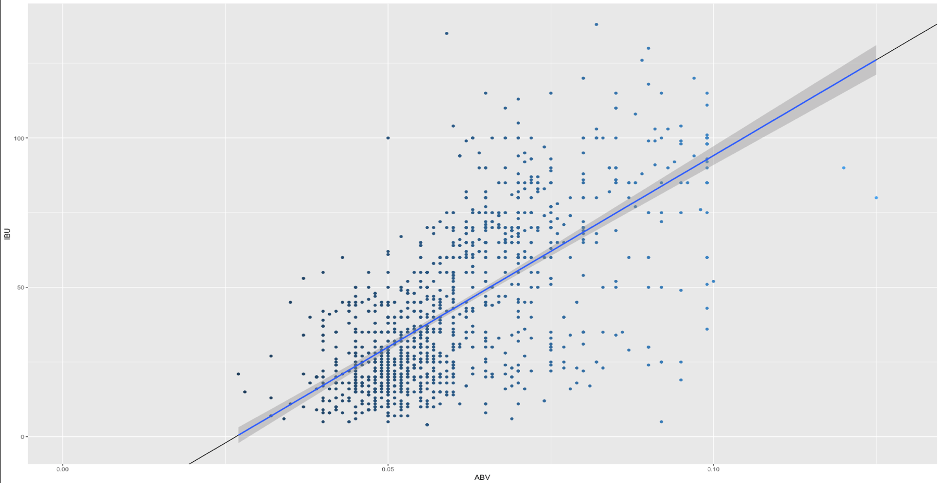
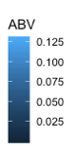
ABV vs IBU
All Available States
STOCK
HOLDER
Daestrunt od qui que sectur as modi cumqui inus si bea non nus exeratio. Mil exerro erferum re corro omnient quam atiat.

Slide 7
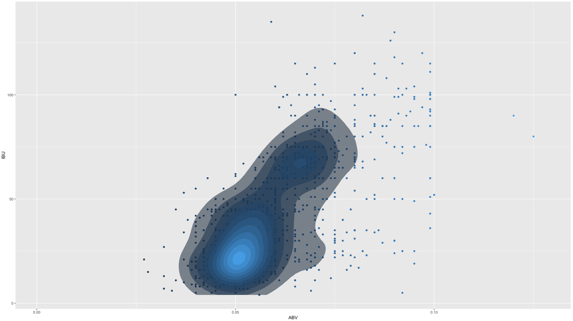
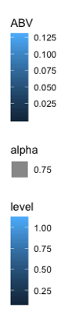
ABV vs IBU Heat Map
All Available States
STOCK
HOLDER
Daestrunt od qui que sectur as modi cumqui inus si bea non nus exeratio. Mil exerro erferum re corro omnient quam atiat.

Slide 8
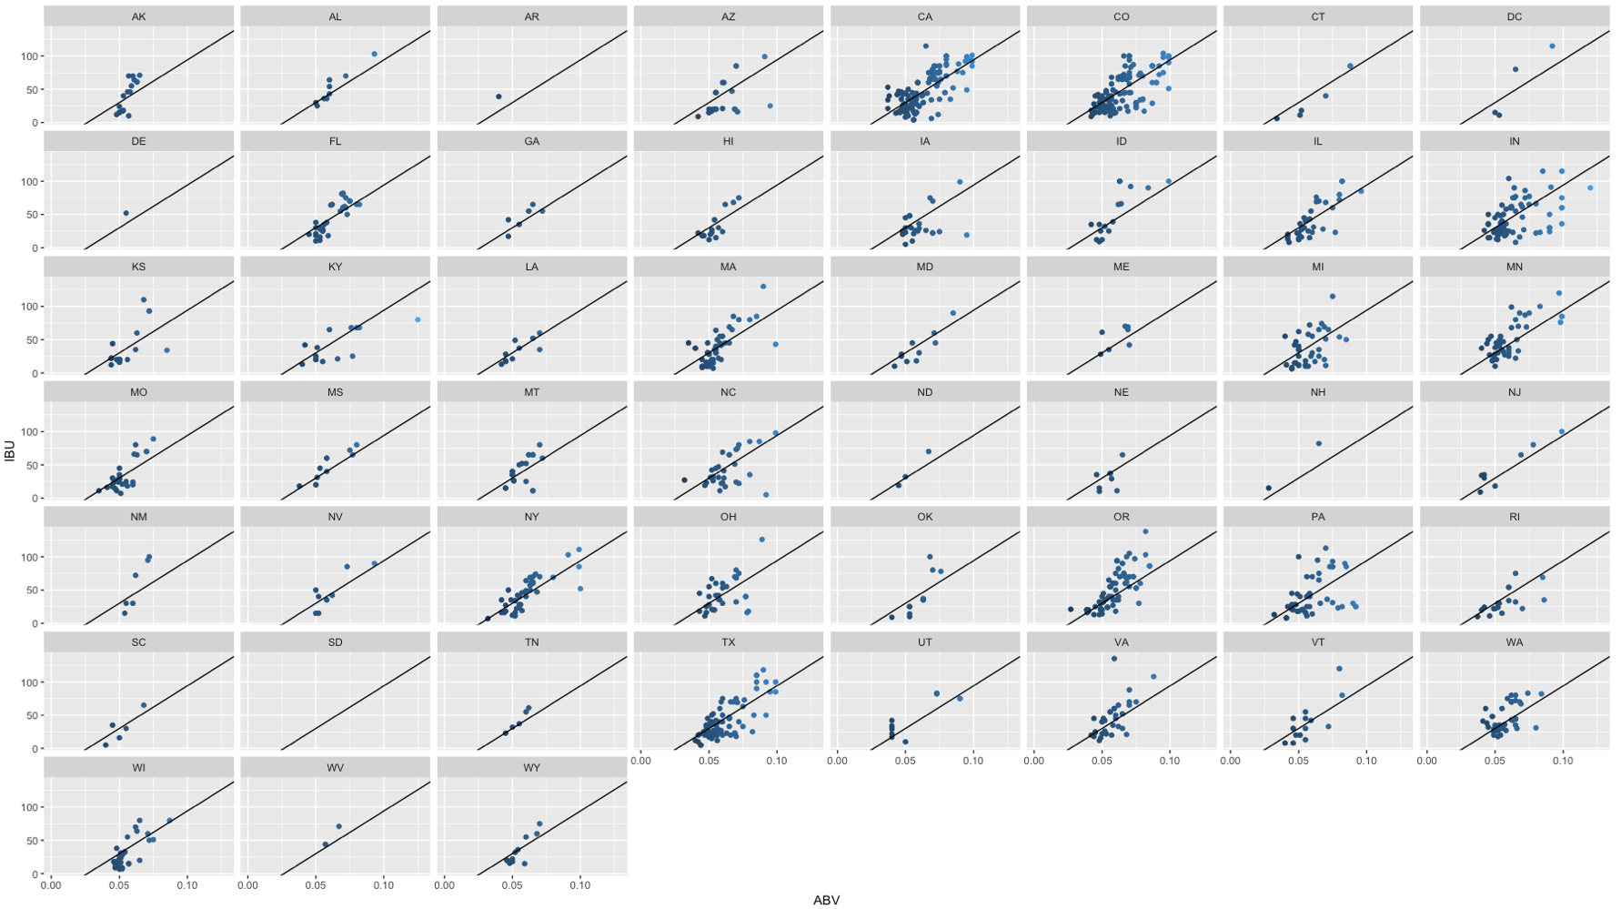
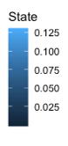
STOCK
HOLDER
ABV vs IBU Per State

Slide 9
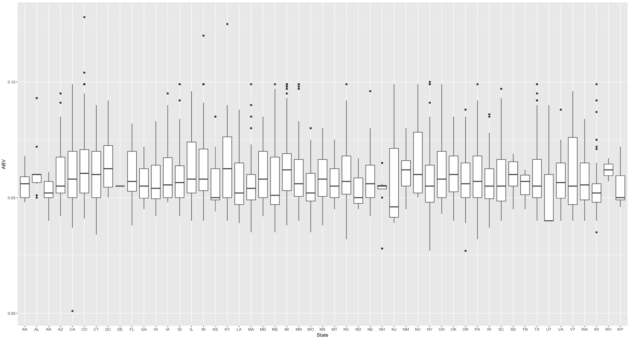
Boxplot of ABV Per State
STOCK
HOLDER
Daestrunt od qui que sectur as modi cumqui inus si bea non nus exeratio. Mil exerro erferum re corro omnient quam atiat.

Slide 10
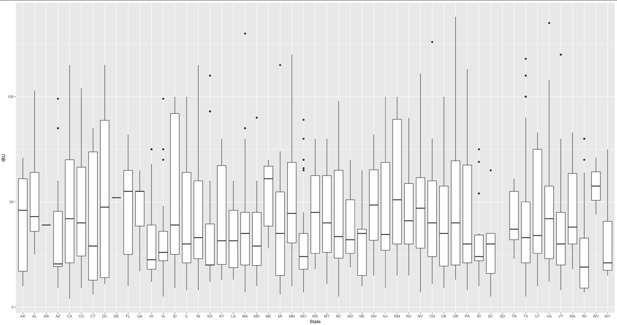
Boxplot of IBU Per State
STOCK
HOLDER

Slide 11
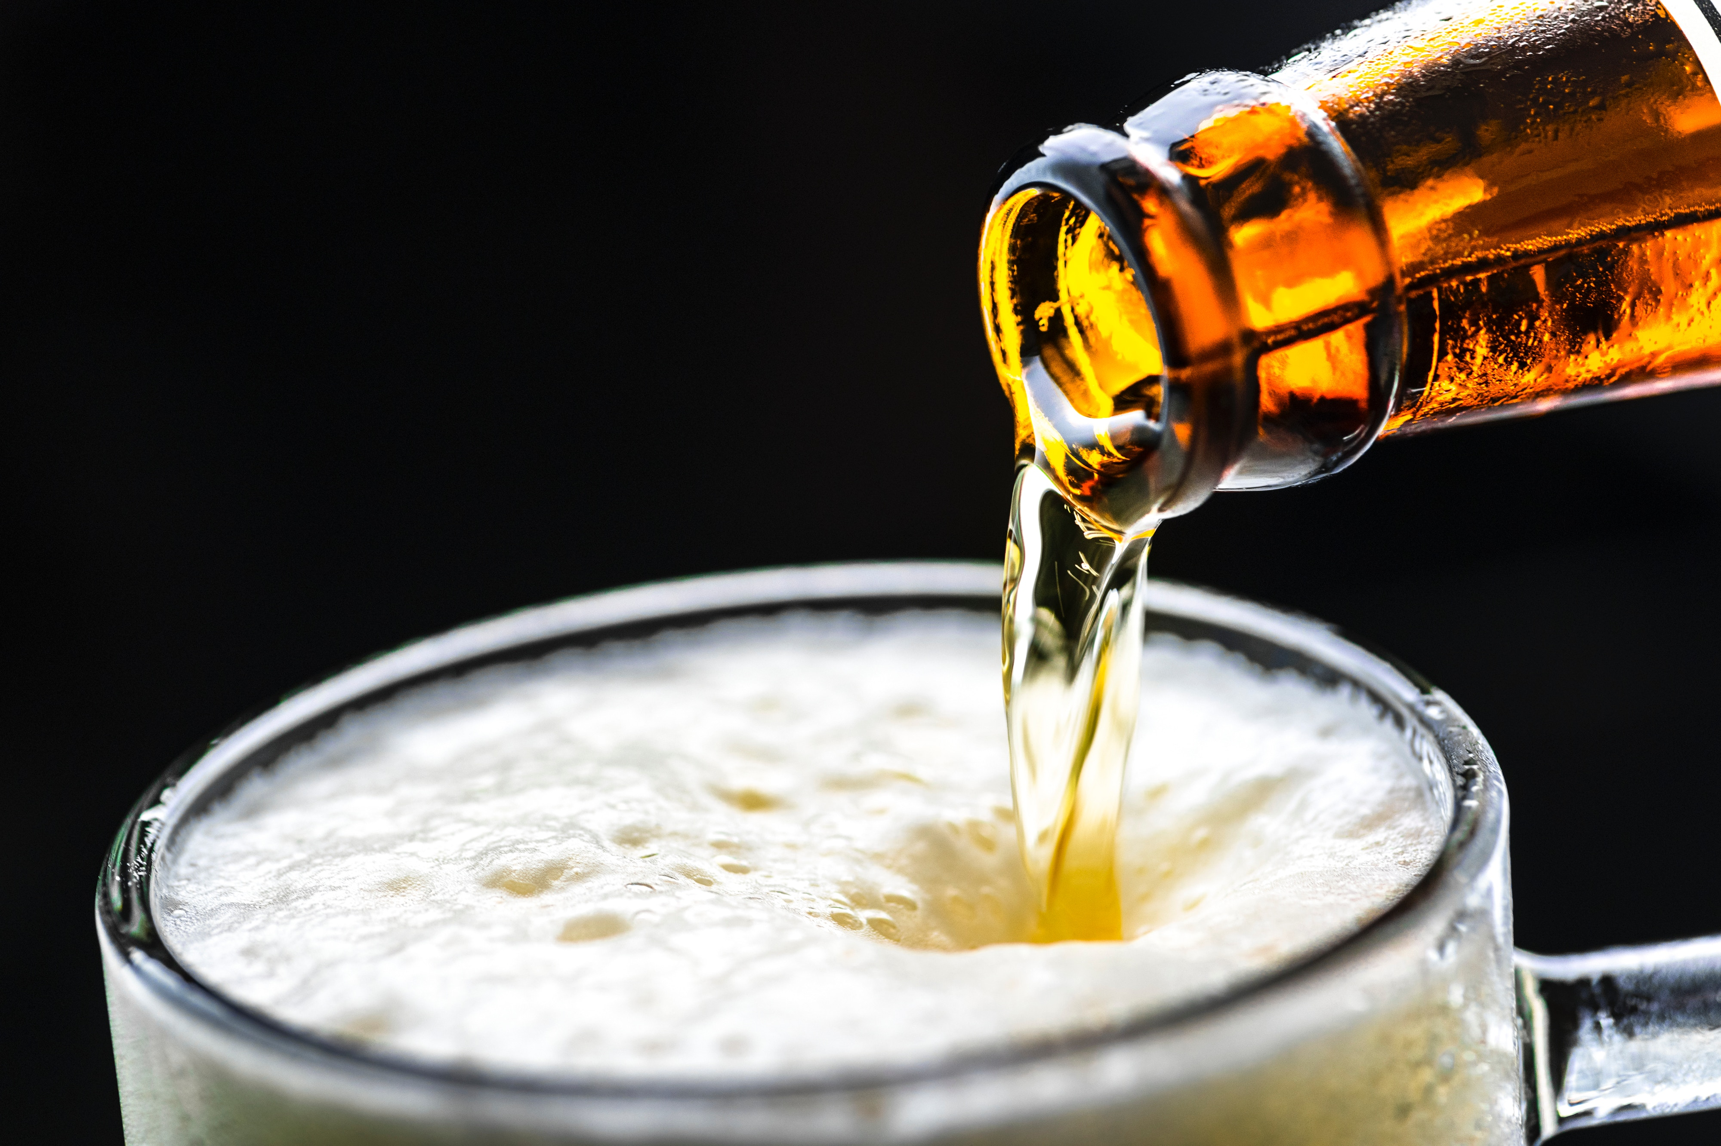
Alcohol By Volume:
Highest ABV (.128)
Upslope Brewing Co, Boulder Co
Lee Hill Series Vol 5
(Quadrupel)
Lowest ABV (.001)
Uncommon Brewers, Santa Cruz CA
Scotty K
(Low alcohol beer)
Highest IBU Value (138)
Astoria Brewing Co, Astoria OR
Bitter Bitch Imperial IPA
(American Double / Imperial IPA)
Lowest IBU Value (4)
Anderson Valley Brewing Co, Boonville CA
Summer Solstice (Cream Ale) 2009/2011
KEY
TAKE
AWAYS
International Bitterness Units:

Slide 12
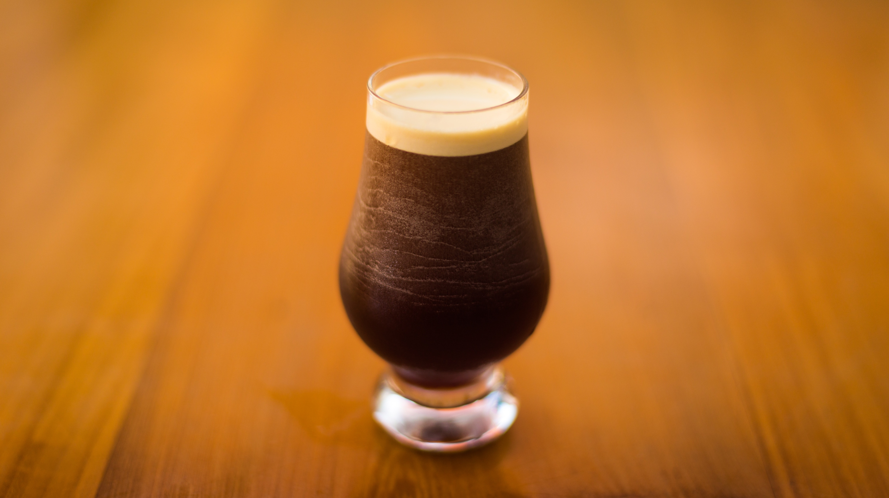
Column Missing Data Count
All other columns had no missing data
Highest IBU Value (138)
Astoria Brewing Co, Astoria OR
Bitter Bitch Imperial IPA
(American Double / Imperial IPA)
Lowest IBU Value (4)
Anderson Valley Brewing Co, Boonville CA
Summer Solstice (Cream Ale) 2009/2011
ABV | IBU | Beer Style
62 | 1,005 | 5
KEY TAKE-AWAYS
International Bitterness Units:
Daestrunt od qui que sectur as modi cumqui inus si bea non nus exeratio. Mil ortodova exerro erferum realer socorro omnient quam

Slide 13
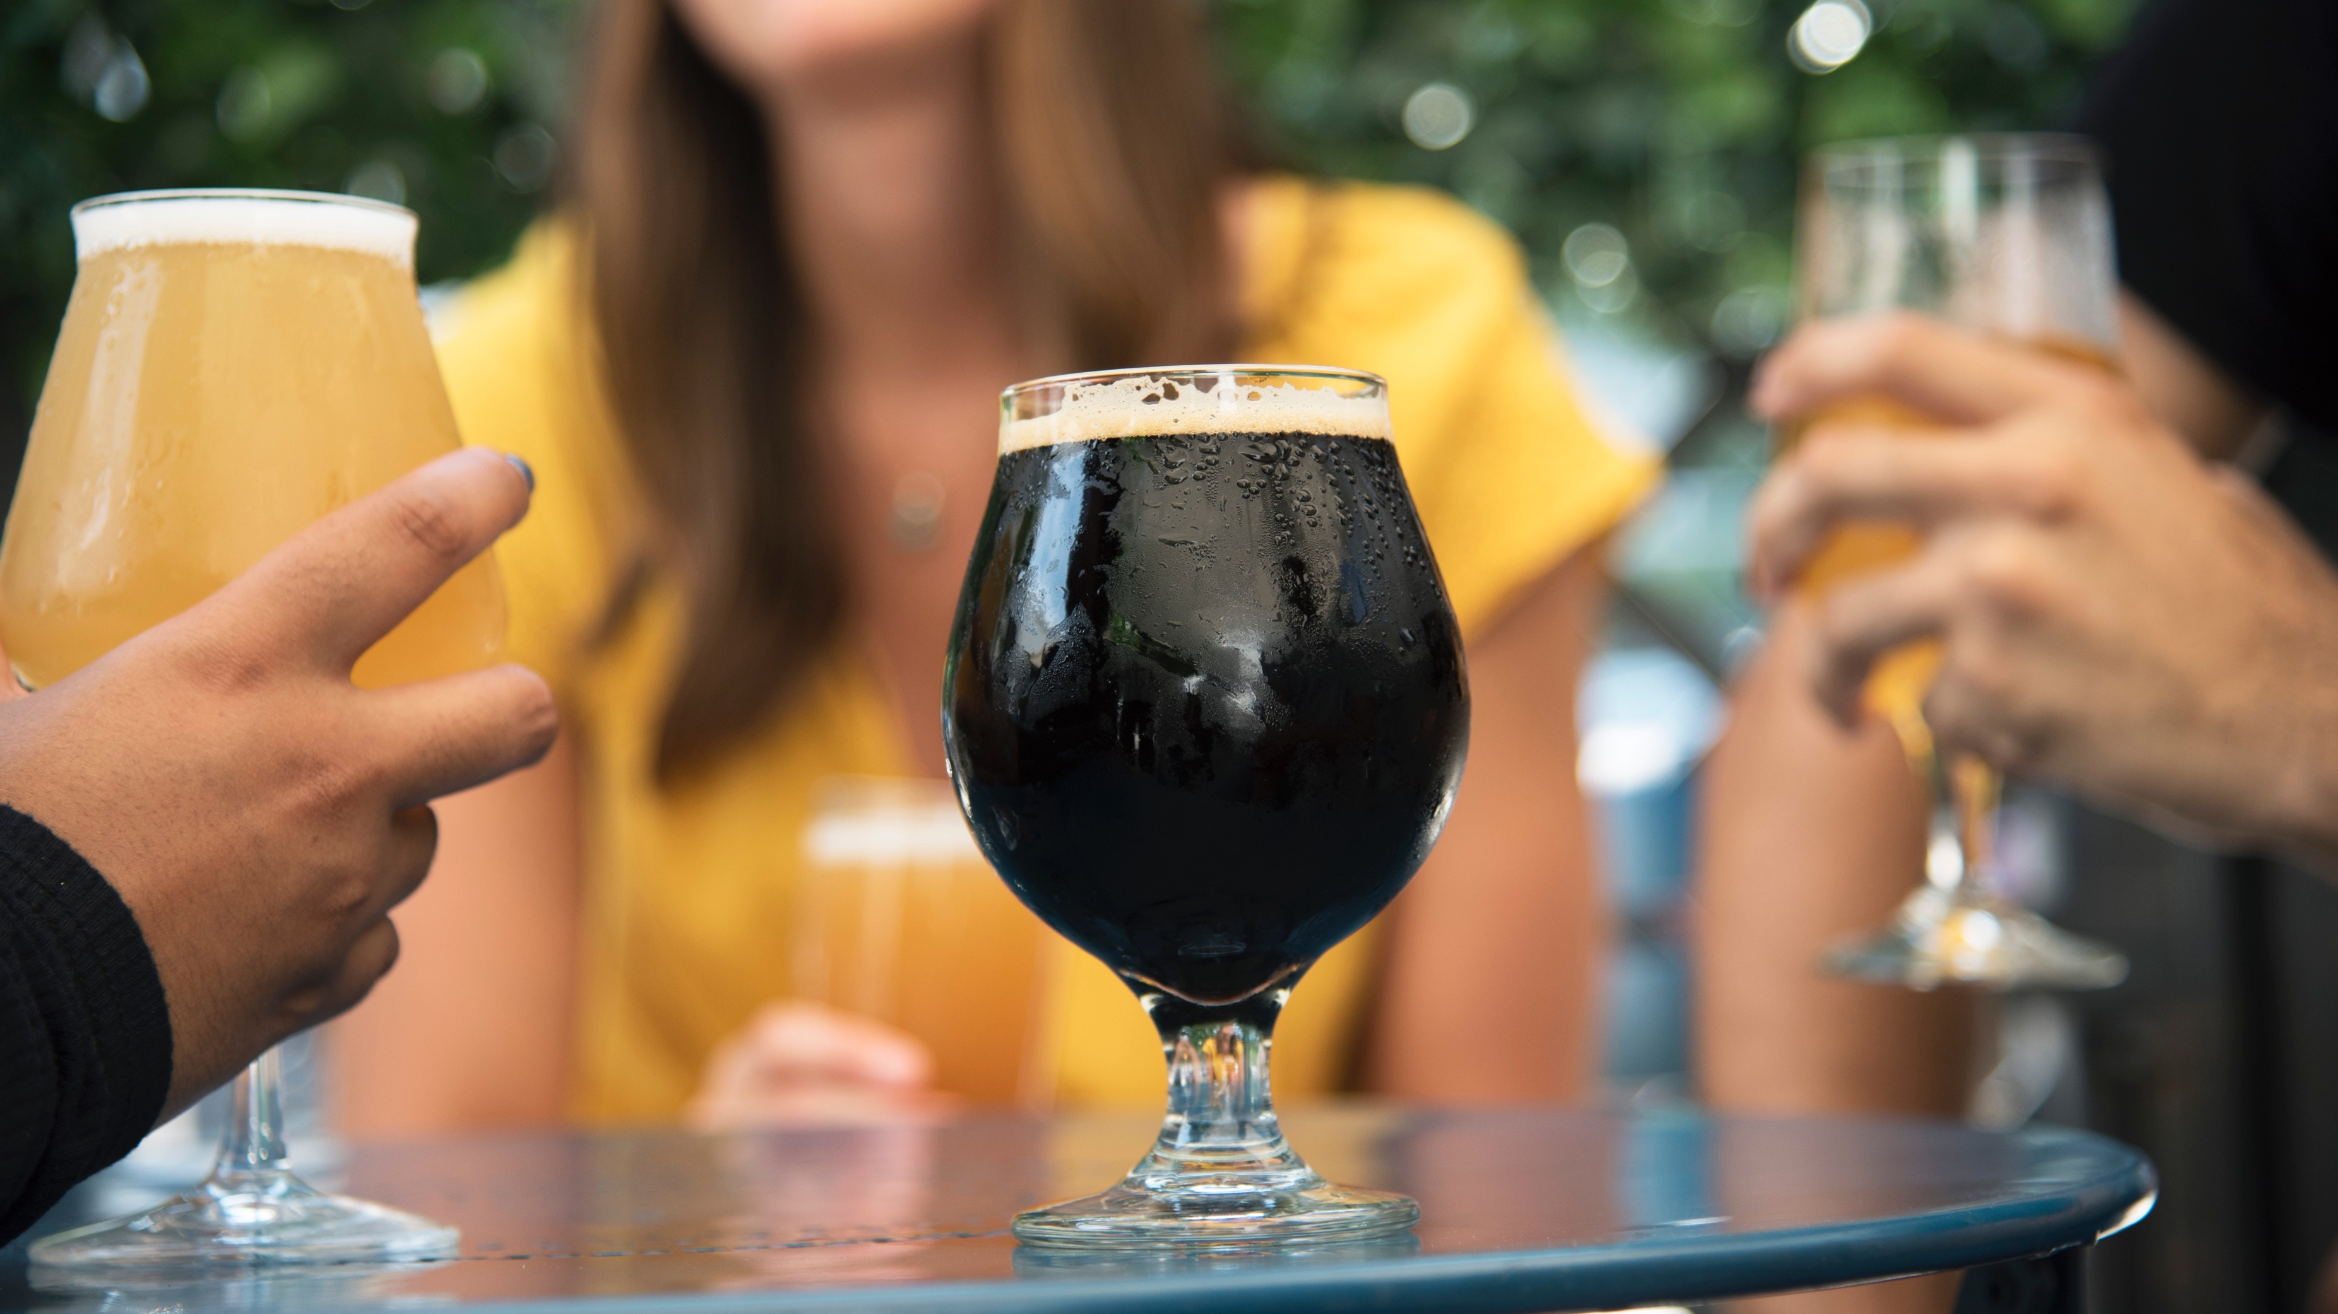
Marketing Channels Data:
Greater insights into craft beer consumer behavior
Sales Volumes
Craft Beer Pricing Data
Raw-material Sourcing Data
Regulatory Atmosphere For Craft Beer
NEXT
STEPS

Slide 14
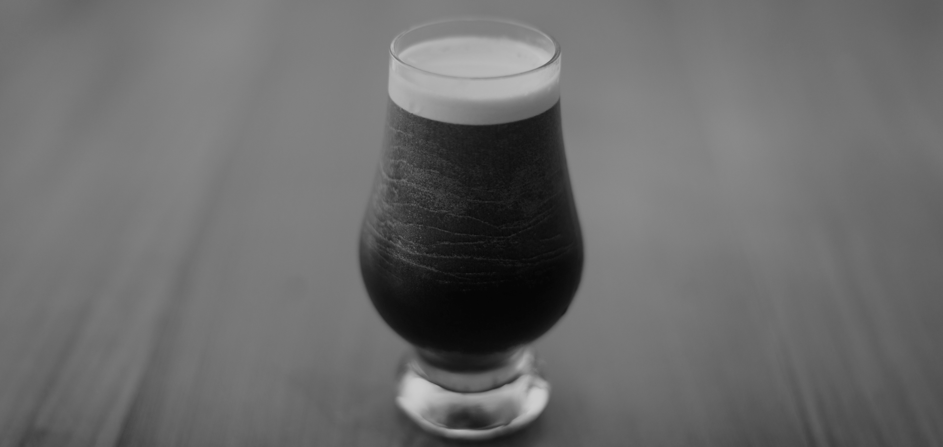
QUESTIONS ?
THANKS
AGH DATA CONSULT INC.
DALLAS, TX

Slide 15
AGH DATA CONSULT INC.
P | 03
AGH
DATA CONSULT Inc.
Data like never Before.
We are a Data Science Group dedicated to helping our clients make sense from their data.

Slide 16
Boxplot of IBU Per State
STOCK
HOLDER

Slide 17
Boxplot of IBU Per State
STOCK
HOLDER

Slide 18
Boxplot of IBU Per State
STOCK
HOLDER

Slide 19
HAMUNRA
P | 46
www.hamunra.co
Section X
Map Graphic
Donec a est at arcu congue congue vel eget ex. Duis auctor lectus maximus sapien suscipit interdum. Curabitur rhoncus,
diam vel congue pulvinar, erat massa lacinia purus, in laoreet purus massa in nunc. Phasellus finibus malesuada lobortis. Sed quis tellus id nulla Nam nec auctor arcu. Aenean molestie lacus ut urna accumsan, a rhoncus orci rhoncus.
76%
FINIBUS NISL UT LIGULA VESTIBULUM,.
Color Code
Color Code
Color Code

Slide 20
HAMUNRA
P | 47
www.hamunra.co
Daestrunt od qui que sectur as modi cumqui inus si bea non nus exeratio. Mil exerro erferum re corro omnient quam atiat.
Borum faciend issumquid explibu sciisquidit vellaborat aut alitatis ut eates aut eum venis suntios sequatu mquodiore nimoluptatem
MAP
OF AMERICA
USA (89%)
MEXICO (80%)
BRAZIL (78%)
Daestrunt od qui que sectur as modi cumqui inus si bea non nus exeratio. Mil exerro erferum re corro omnient quam atiat.

Slide 21
HAMUNRA
P | 05
www.hamunra.co
The Top That
Worth to Climb
ROVER FALCON Jr.
Lorest que nosam restiatquia ides escimint ommo blab imagni te nis dolorectur? Ruptia volut vera sequiatus ipsaest mod ulla verciunt, corem ium estrum fugia vollorerum quae. Nequodipsae nam, comnihilit doluptatem expliqu
Solorum verum excestrum et rae conseque niet estrum lab il id min ra quam que milis ipsae dolum quianimpos excerro eaquo bearum voluptasped explist que pos eum endusdae voluptaspe num idesti omniateculpa quas sequaerum que iunt autam faccabo. Neque perum que prae occus molorerem nis expella dolore officia eptiae pliquis
Our Founder

Slide 22
HAMUNRA
P | 11
www.hamunra.co
Section X
Case Studies
Daestrunt od qui que sectur as modi cumqui inus si bea non nus exeratio. Mil exerro erferum re corro omnient quam atiat.
Borum faciend issumquid explibu sciisquidit vellaborat aut alitatis ut eates aut eum venis suntios sequatu mquodiore nimoluptatem nescit, ut latatur, omnient que sitam aut audam et ide minvendant oditaerest aut faccus sinisquis non planiat aut aut re aut hitat magnatistio. Ehendam velitatum aut ulparum expliberorem quiscid molorest eat volorporae mint ide sedicim invente ctemporrum ium et et, acerepe rfernatecto con cus.
Mosae ate restia volectatis ide num consequo ma quate verum iditas maximpor molupti volorit, eum im imus endi con et volest, suntem issequi dolum, oditaqui doluptia.
Tittle Here
Tittle Here
Ristiores il intia vendia nobis con
plit est reperepe modigentinus.
Ristiores il intia vendia nobis con
plit est reperepe modigentinus.
Ristiores il intia vendia nobis con
plit est reperepe modigentinus.
Endia nobis con plit est repere
Endia nobis con plit est repere
Endia nobis con plit est repere

Slide 23
Index
Nem re net quaernat dem repellatis voluptatint, sam int eserion custrum arum hit restia sunt omnimpe officab iur? Uditi odit volor sam que debis molorat quatiatus at porem quibus, sandelibus aborerum lant ideniet voluptin eiumque.
Section
Section
1
3
Uptibus Accum Fugiassit
Di Sequidipist Sed Eos
Susti Utas Dunt Soloraeperum
Sequatia Doluptatem Et Aut Quae
Nihil Iunt Dolo Imint, Voluptaestia
Siti Volupta Tiuris Aut Re Velibus
00
01
02
03
04
05
Uptibus Accum Fugiassit
Di Sequidipist Sed Eos
Susti Utas Dunt Soloraeperum
Sequatia Doluptatem Et Aut Quae
00
01
02
03
Contents
Section
Section
2
4
Uptibus Accum Fugiassit
Di Sequidipist Sed Eos
Susti Utas Dunt Soloraeperum
Sequatia Doluptatem Et Aut Quae
Nihil Iunt Dolo Imint, Voluptaestia
00
01
02
03
04
Uptibus Accum Fugiassit
Di Sequidipist Sed Eos
Susti Utas Dunt Soloraeperum
Sequatia Doluptatem Et Aut Quae
Nihil Iunt Dolo Imint, Voluptaestia
Siti Volupta Tiuris Aut Re Velibus
00
01
02
03
04
05

